Slide 1
Chapter 1
Basic concepts

Slide 2
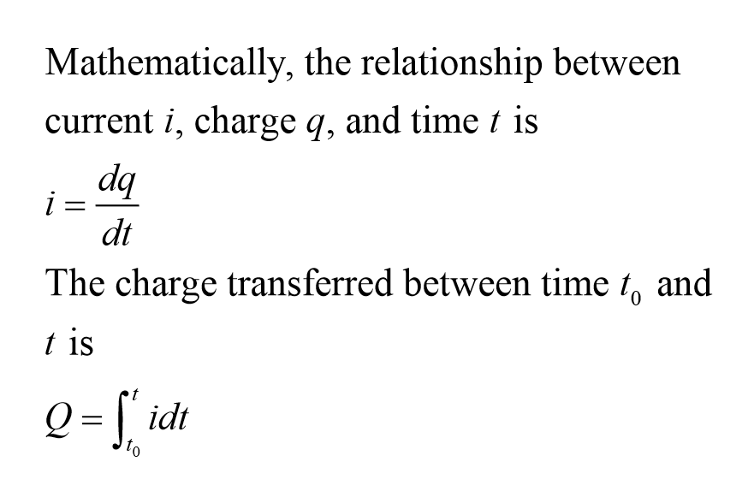

Slide 3
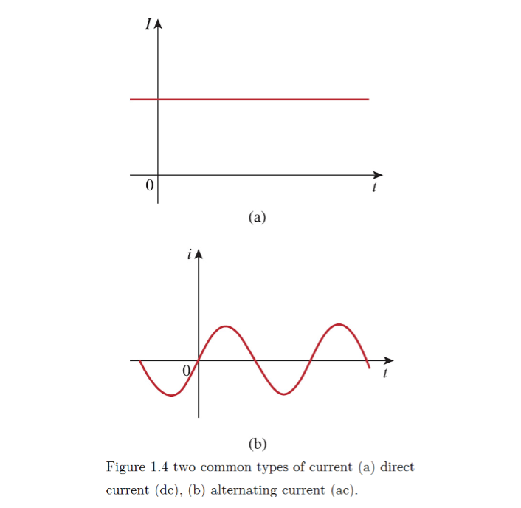
Understand the concept and can figure out the difference.
Be careful when doing lab.

Slide 4
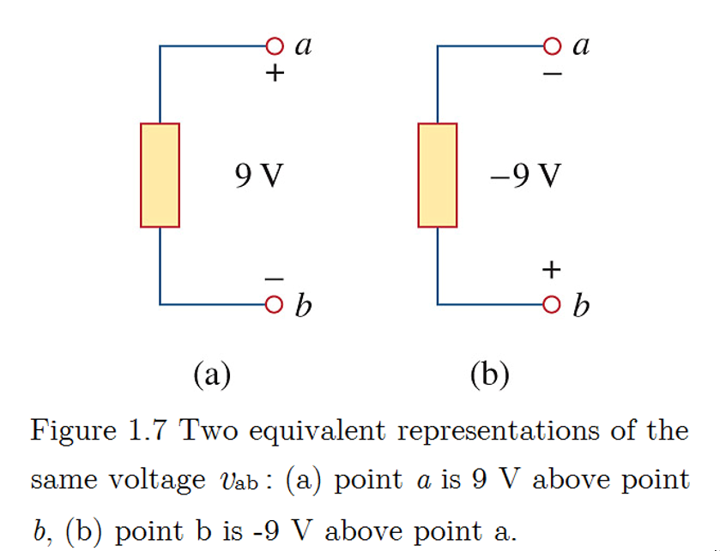
The key is to judge the voltage difference between the point a and b, not the number it shows.

Slide 5
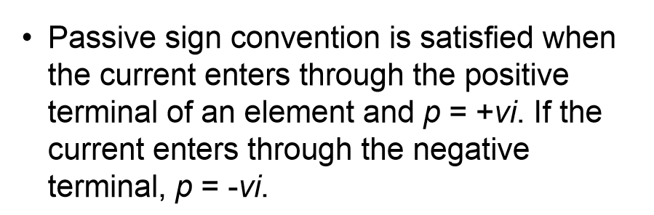
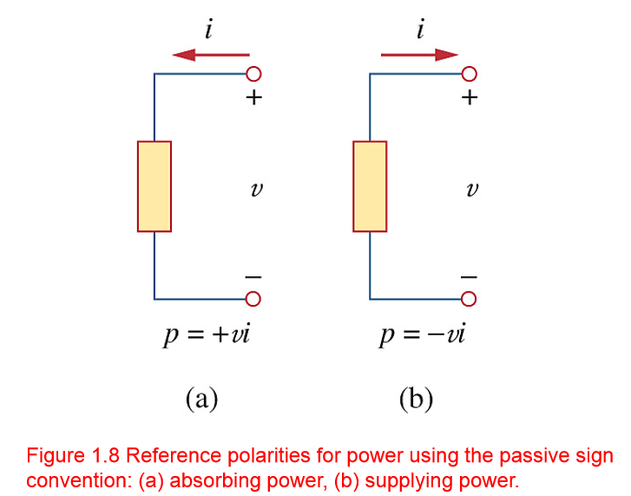
To help remember:
Left is bulb.
Right is battery.

Slide 6
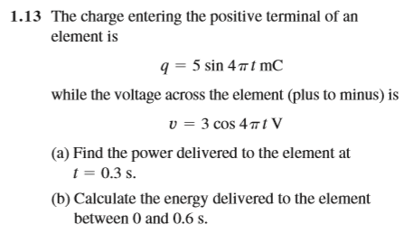

Slide 7
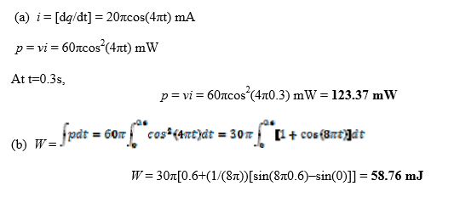

Slide 8
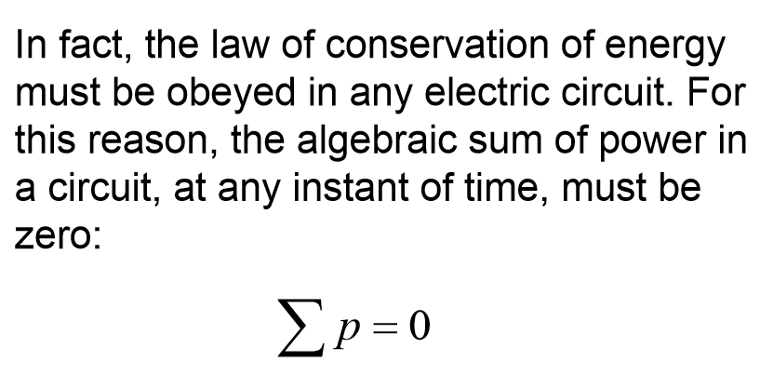
Most basic and important concept.
The methods we learn to solve the problem almost derived from this.

Slide 9
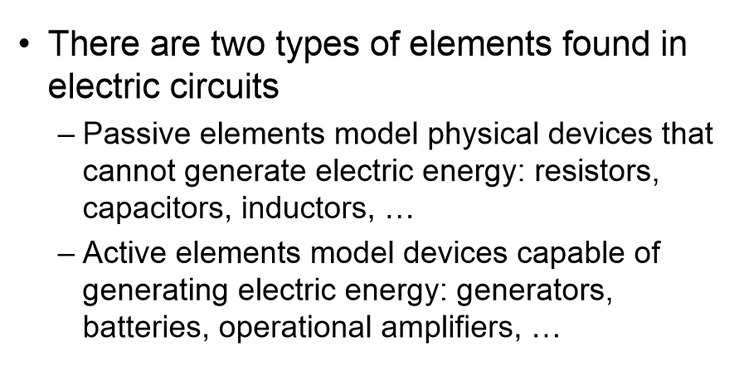

Slide 10
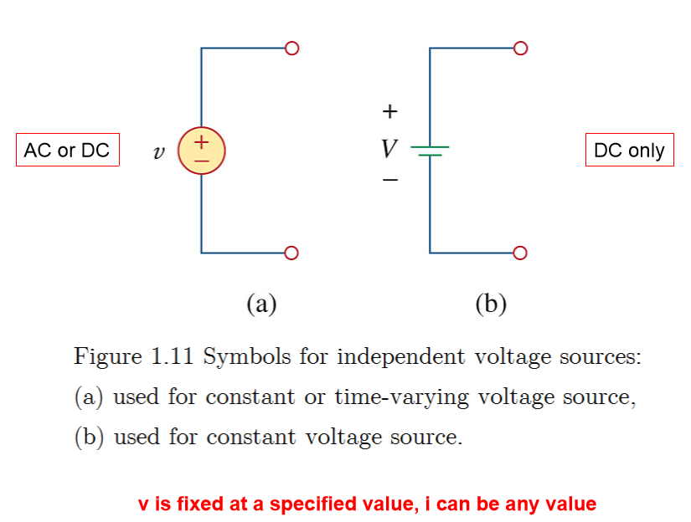
Independent source

Slide 11
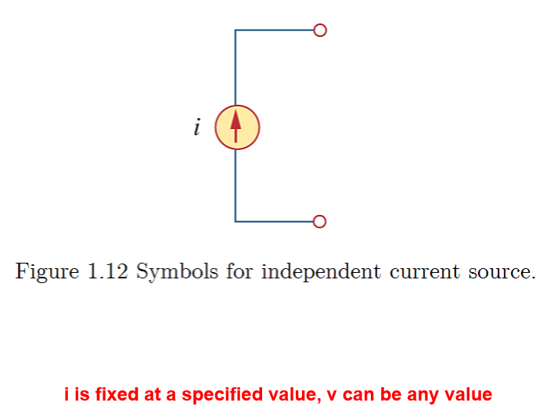
Independent sources are different from the ideal sources.
Ideal sources are the sources which can steadily provide the voltage or current.

Slide 12
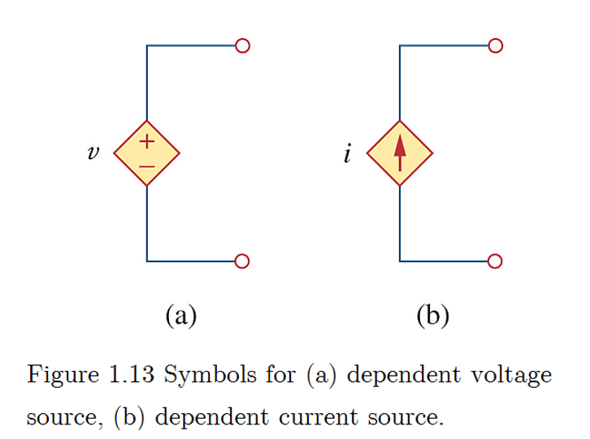
Dependent source
Remember the symbols for different types.

Slide 13
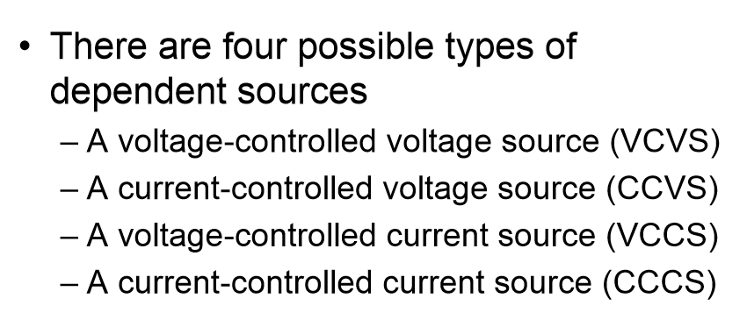
The key is control, who controls who and what source?

Slide 14
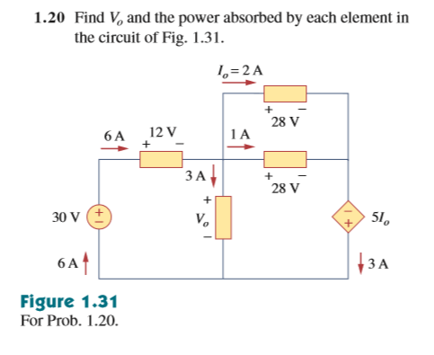

Slide 15
